Slide 1
Green Sight AI
2026/05/07
Session [3] — Group [9]

Slide 2
The problem
Our product
01
02
CONTENTS
Validation evidence
Application prospects
03
04

Slide 3

The problem
Students, home gardeners, and small greenhouse operators often overlook environmental parameter fluctuations (temperature, humidity, air pressure) and early abnormal plant symptoms, leading to plants being noticed only after obvious problems appear.

Slide 4
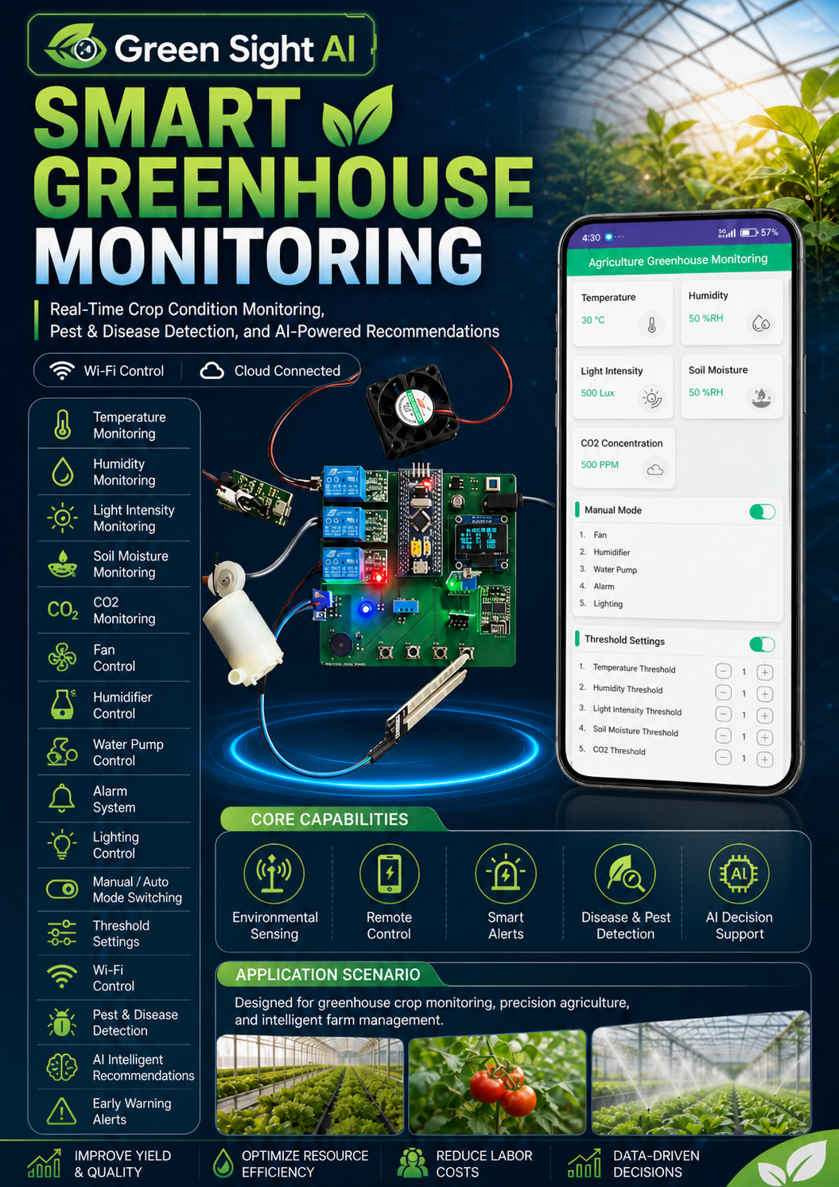
Our product
The Green Sight AI product provides users with an easy way to track the condition of plants and know when attention is needed. It not only displays values such as temperature and humidity but also provides alerts when the values are abnormal.

Slide 5
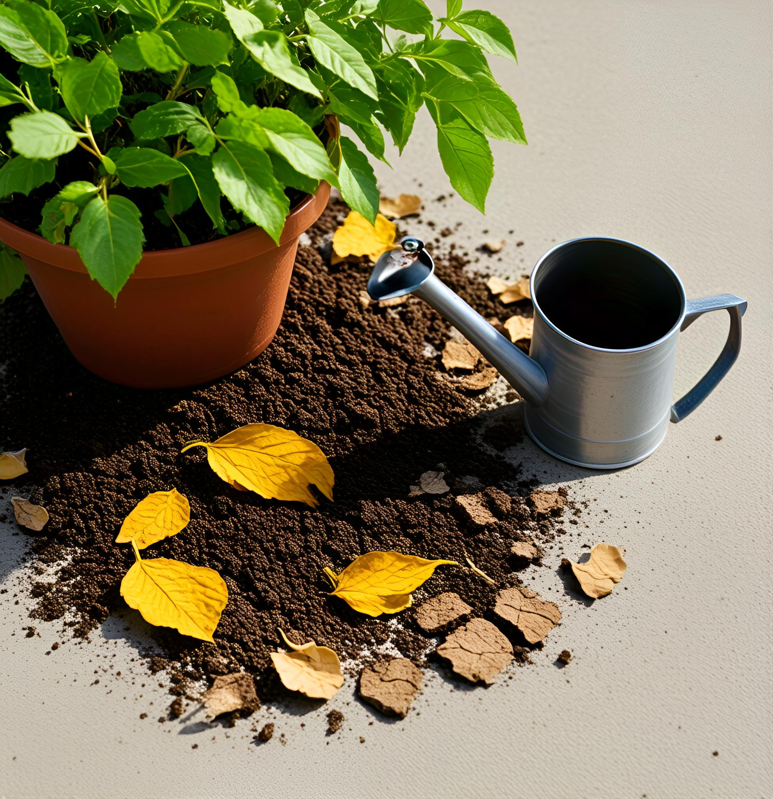
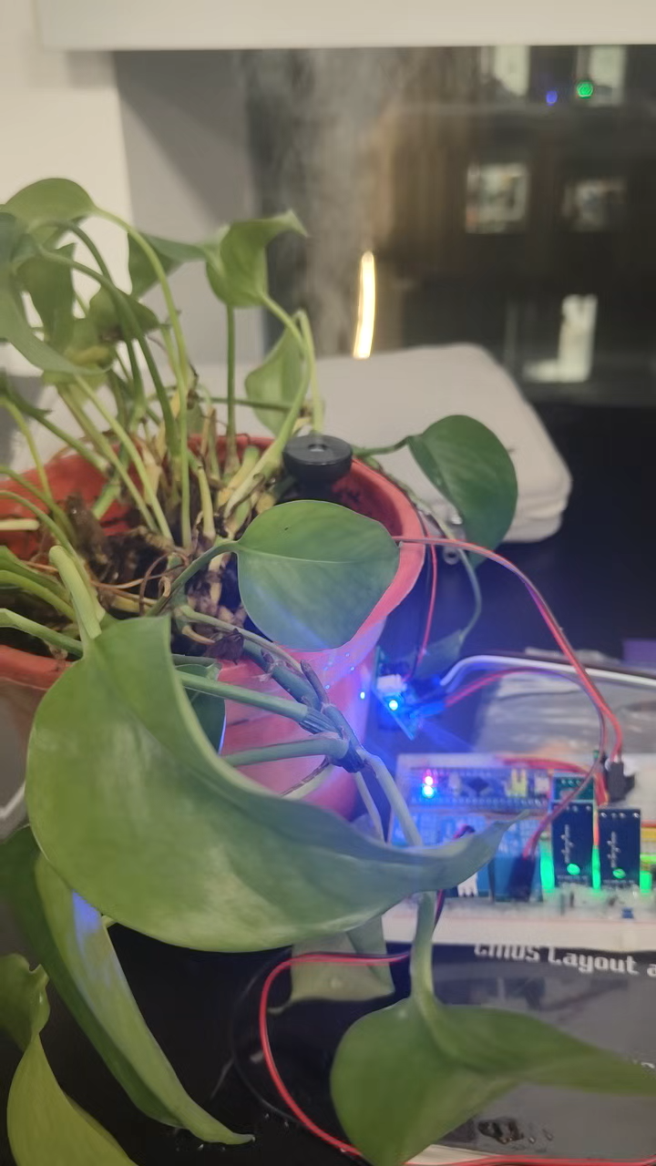
Demo demonstration

Slide 6
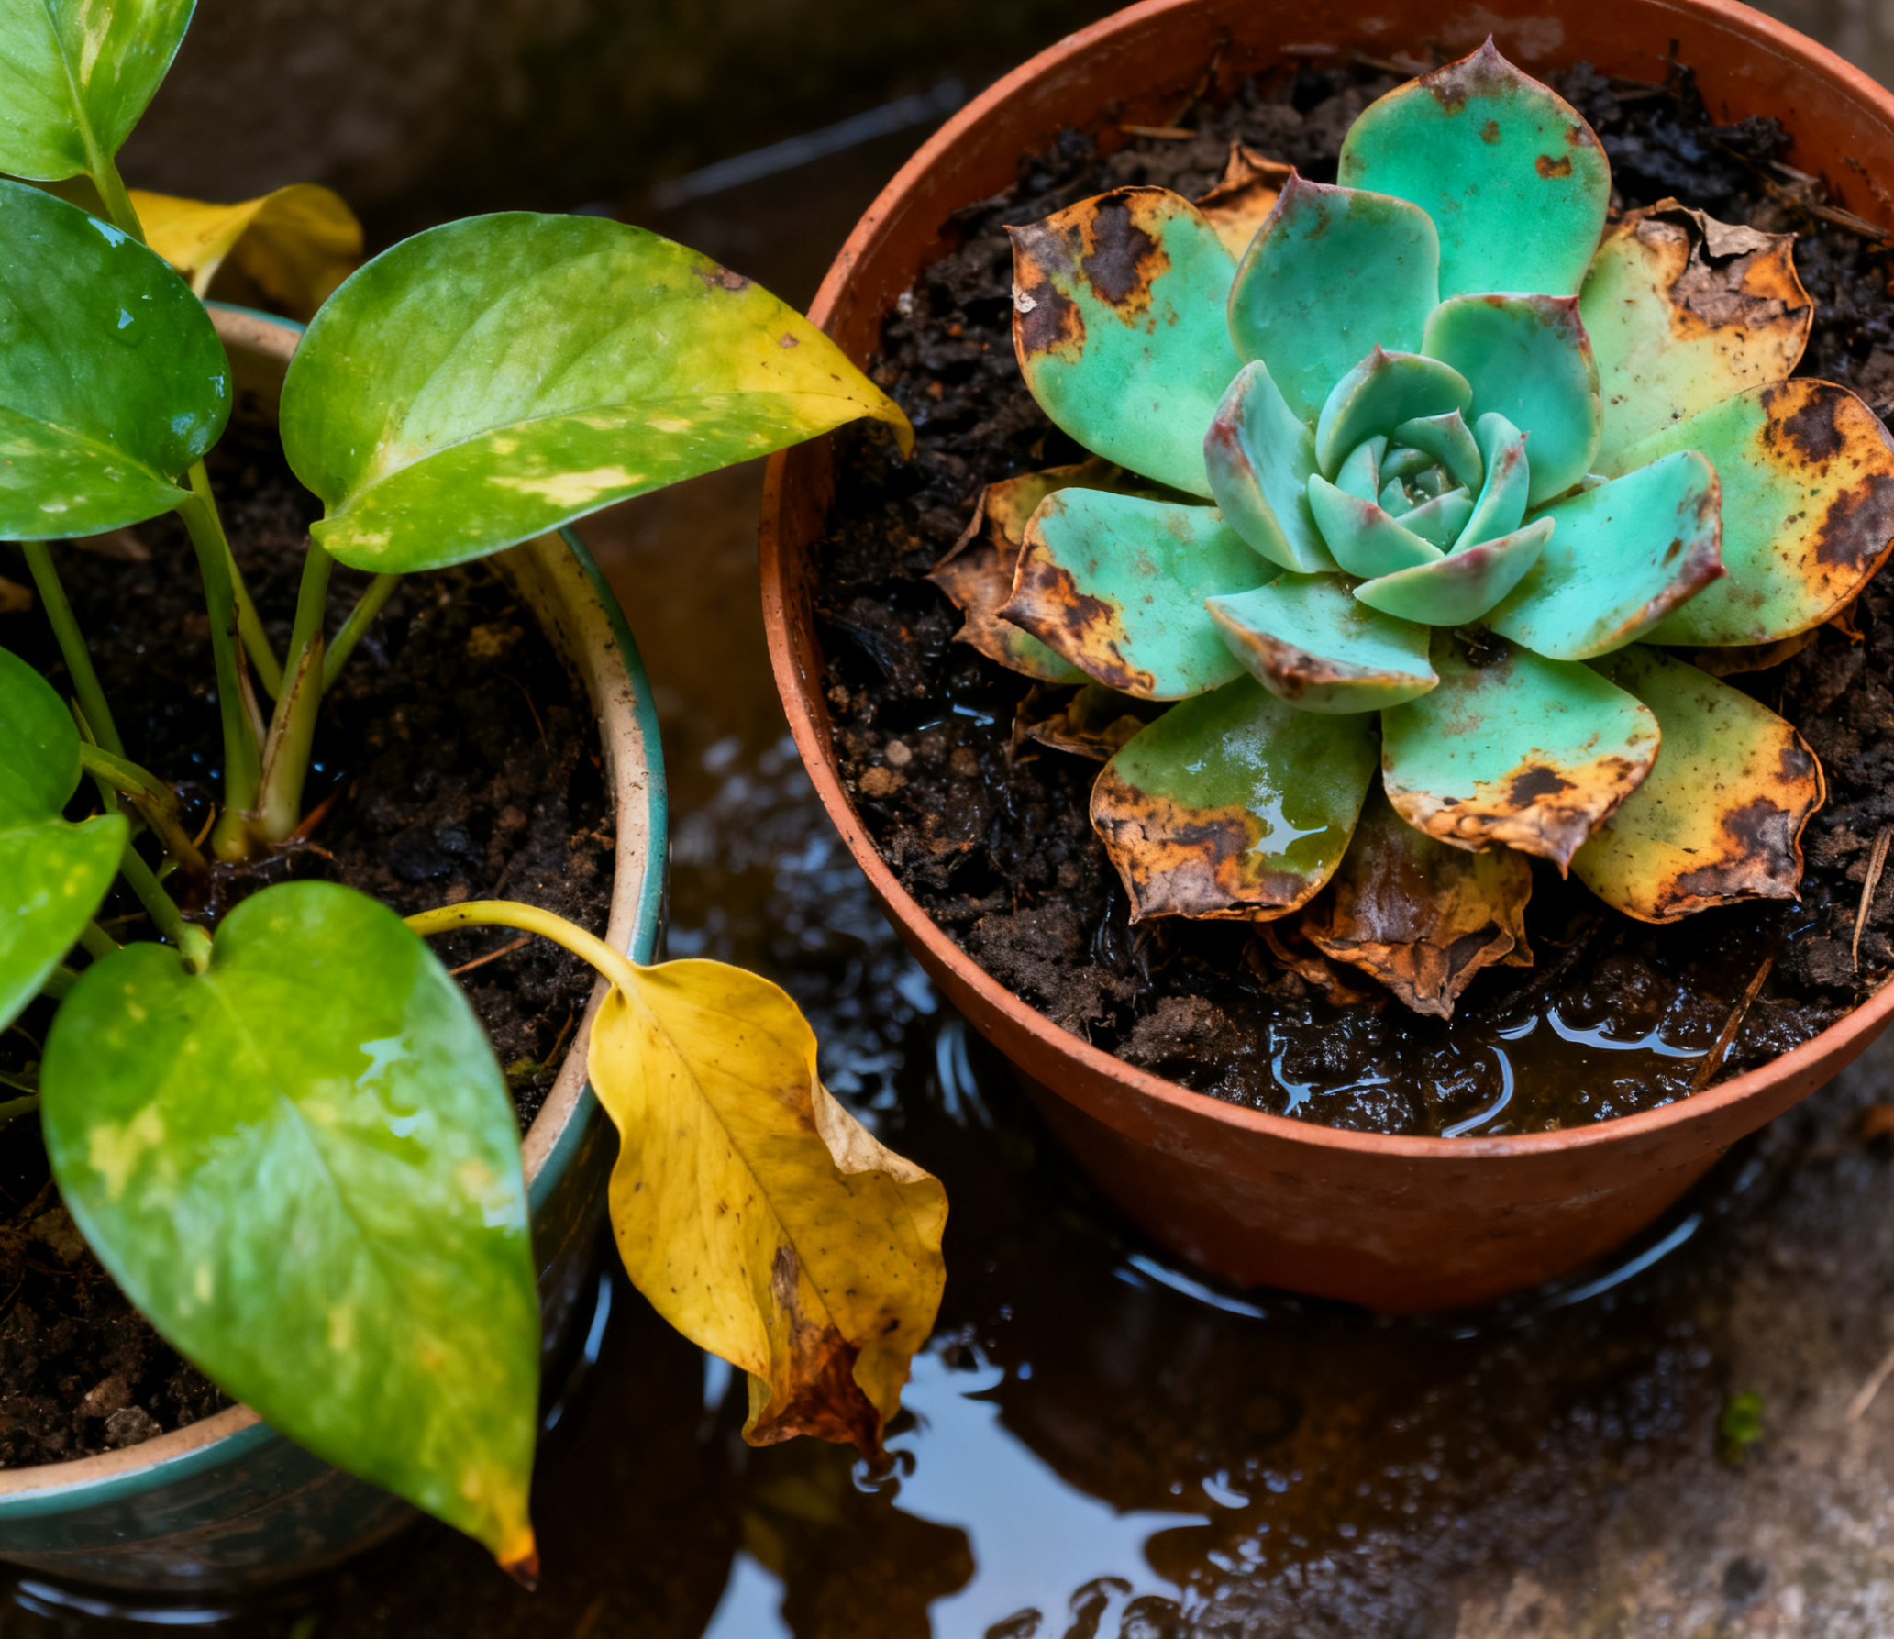
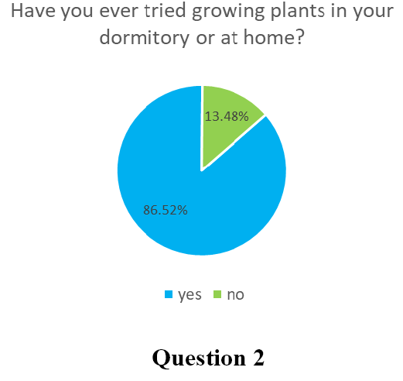
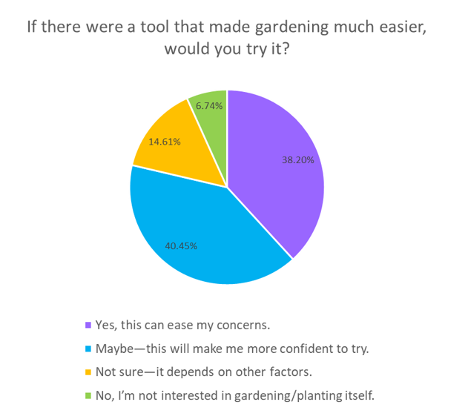
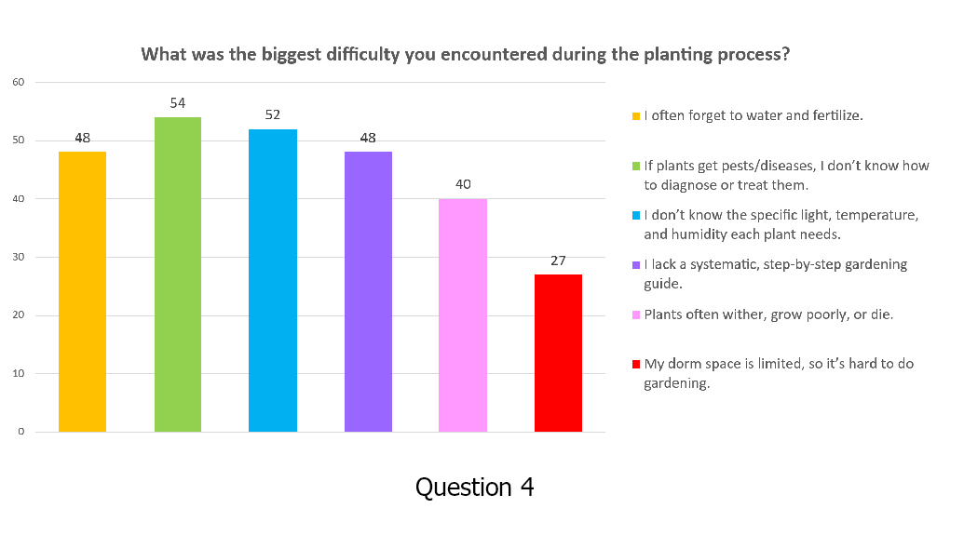
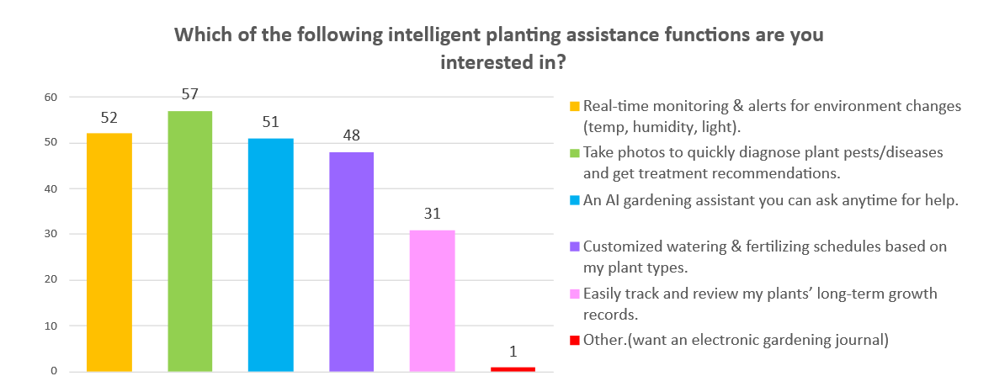
Validation evidence
As many as 86.52% of respondents have tried growing plants in their dormitories or homes; among those who have not tried (Q11), if there were tools to reduce the difficulty, 78.65% (38.2% would + 40.45% might) are willing to start trying.
Based on the analysis and summary of the survey results, the drawbacks of traditional planting methods for the target group are as follows: blind spots in plant disease and pest control, lack of understanding of the light, temperature, and humidity conditions needed by plants, and often forgetting to water and perform daily maintenance.

Slide 7
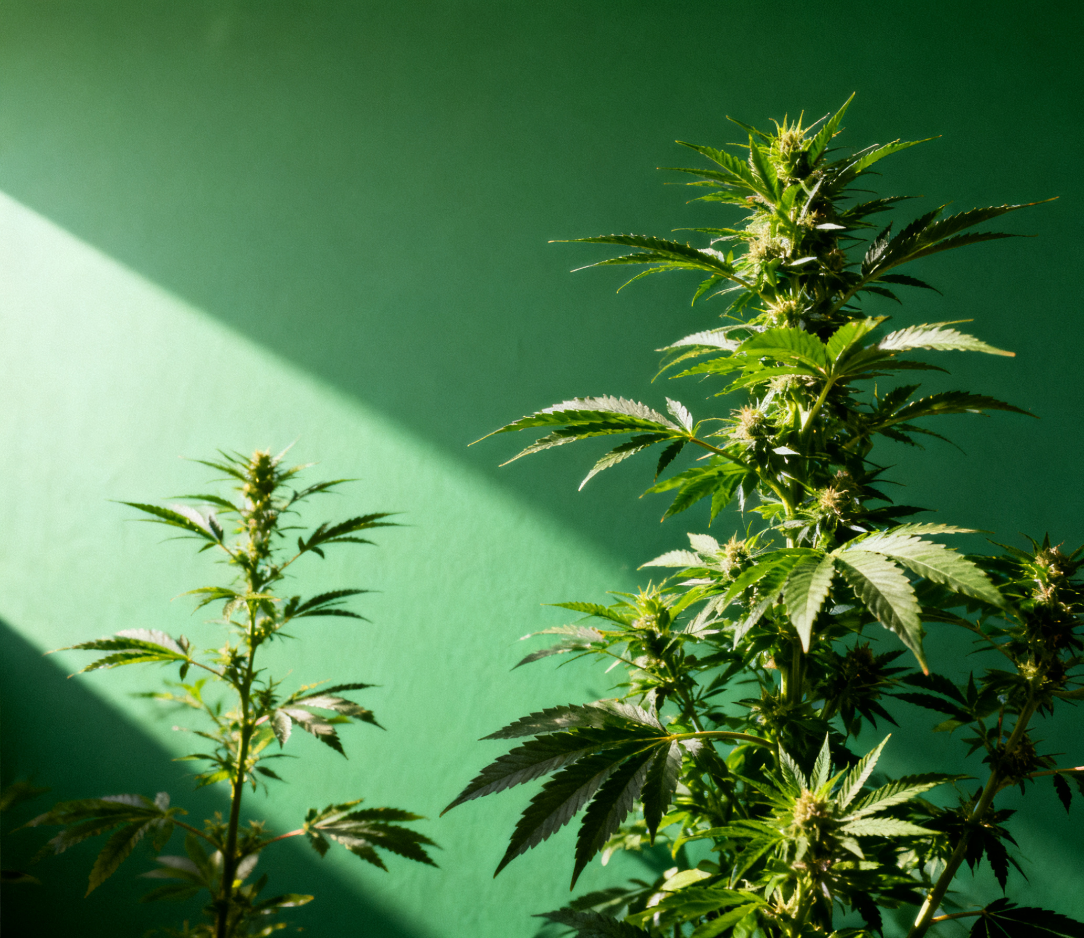
Application prospects
Personal cultivation
The product addresses the pain points of traditional manual monitoring through simplified operations and real-time alerts.
education and popular science field
The product can be used as a STEM education tool to help students intuitively understand the environmental parameters of plant growth.
By presenting data visually and providing plant health guidance, attract non-professional users to participate in scientific practice, meeting the needs of schools and community science popularization activities.
small-scale agriculture and vertical farming
Green Sight AI's real-time monitoring and alerting features can reduce crop losses

Slide 8
THE END

